Slide 1

Swafinix Investment Opportunity
Confidential Board Presentation | LP Investor Review

Slide 2
EXECUTIVE SUMMARY
Investment Highlights
Strong Market Position
Exceptional Growth
Proven Leadership
Clear Value Creation
Experienced management team with successful exit track record
Leading innovator with proven track record in high-growth sector
3-year CAGR of 45% with expanding margins and market share gains
Multiple paths to 3-5x return within projected investment horizon

Slide 3

MARKET OPPORTUNITY
Significant Market Tailwinds
Market Dynamics
$48B
The addressable market is experiencing unprecedented growth driven by digital transformation and regulatory changes. Industry analysts project the total addressable market will reach $48B by 2028, representing a 28% CAGR.
TAM by 2028
Total addressable market size with strong momentum
Swafinix is uniquely positioned to capture disproportionate share through its differentiated technology platform and established customer relationships.
28%
Market CAGR
Compound annual growth rate through 2028
$12B
Current Market
Today's market size showing rapid expansion

Slide 4
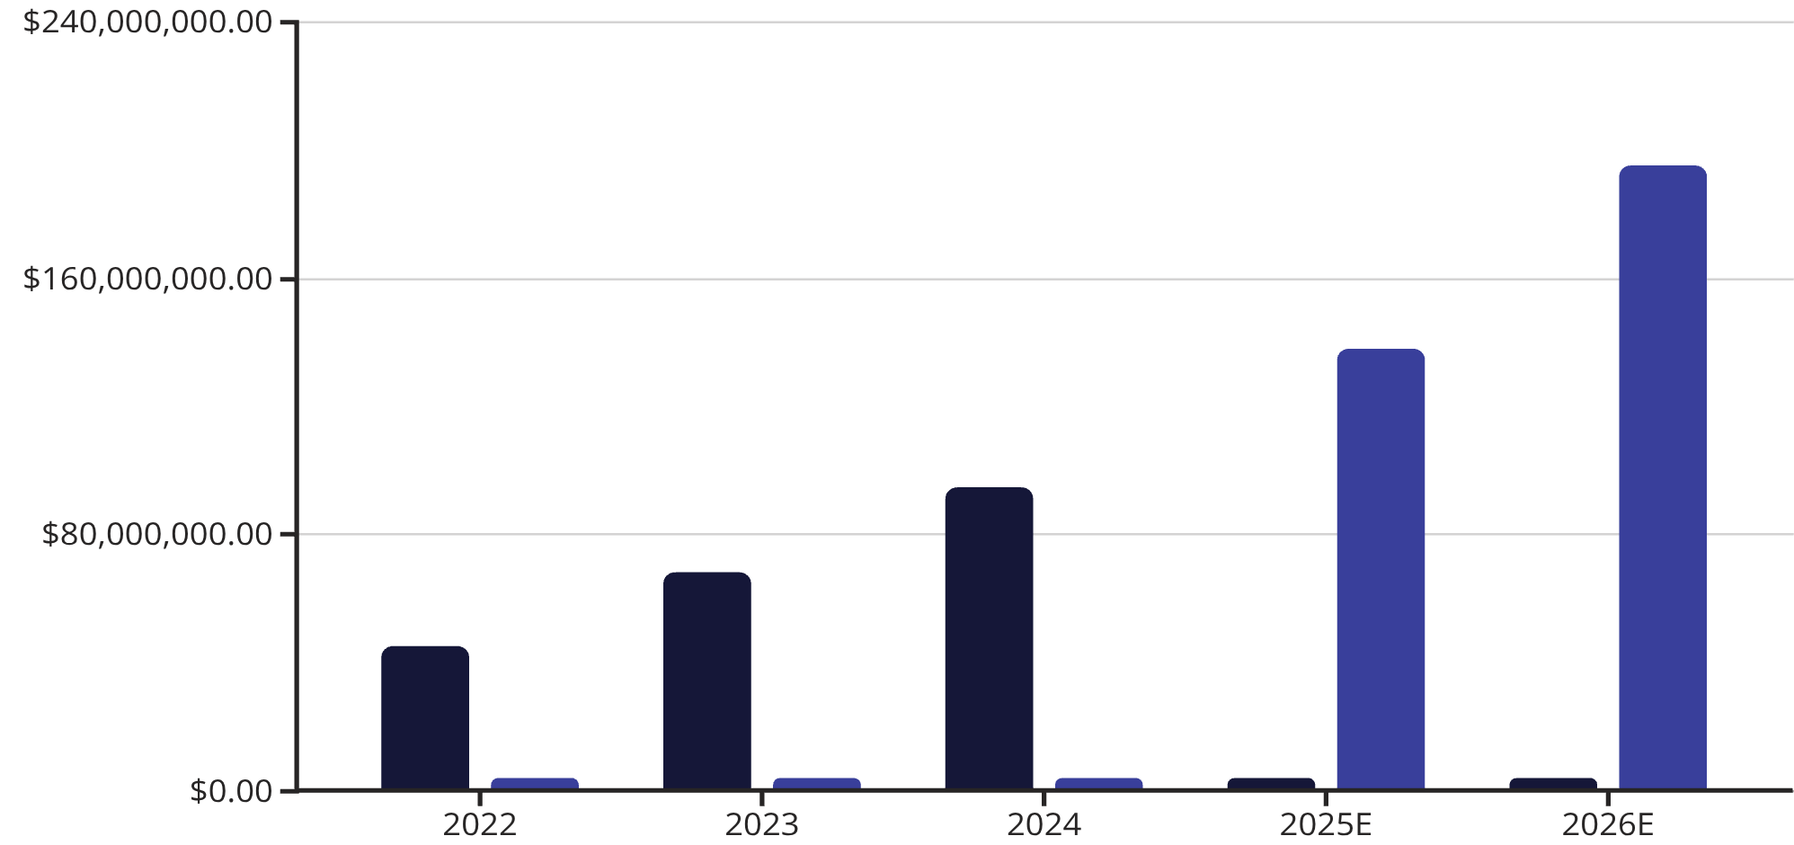
MARKET OPPORTUNITY
Revenue Growth Trajectory
Sustained Momentum
Historical performance demonstrates consistent execution against ambitious growth targets. The company has exceeded plan in 11 of the last 12 quarters.
Forward projections are based on conservative assumptions around customer acquisition, retention rates, and market penetration in existing segments.
Revenue
Projected

Slide 5



COMPETITIVE ANALYSIS
Differentiated Competitive Position
Technology Leadership
Customer Retention
Strategic Partnerships
Industry-leading 96% retention rate and NPS score of 72, significantly outperforming peer average of 58.
Proprietary platform with 18 issued patents creates significant barriers to entry and enables 40% faster deployment than competitors.
Exclusive partnerships with three top-tier enterprise platforms provide distribution advantages and credibility.

Slide 6
FINANCIAL OVERVIEW
Strong Unit Economics & Margin Profile
Customer Acquisition
Customer Lifetime Value
Margin Expansion
CAC: $12,500
LTV: $187,000
Gross Margin: 78%
Payback: 11 months
LTV/CAC: 15x
EBITDA Margin: 24%
Efficient go-to-market motion with improving economics as brand scales
Strong retention and expansion drive exceptional unit economics
Operating leverage evident with path to 35%+ EBITDA margins at scale
The business demonstrates attractive SaaS characteristics with predictable recurring revenue (ARR of $89M), strong cash generation, and clear path to profitability expansion as the company scales.

Slide 7





INVESTMENT THESIS
Compelling Value Creation Opportunity
Market Leadership
M&A Acceleration
Operational Excellence
Capture 12% market share in rapidly expanding $48B TAM through product innovation and geographic expansion
Strategic bolt-on acquisitions to expand capabilities, enter adjacent markets, and consolidate fragmented landscape
Drive margin expansion to 35%+ EBITDA through automation, process optimization, and economies of scale
Target Returns
Investment Highlights
Base Case: 3.2x MOIC | 28% IRR
Proven management team with track record
Scalable platform with minimal capex
Strong competitive moats and IP protection
Clear path to market leadership
Upside Case: 5.1x MOIC | 42% IRR
Multiple exit paths including strategic sale or IPO within 4-5 year timeframe

Slide 8



MANAGEMENT TEAM
Experienced Leadership with Proven Track Record
Sarah Chen, CEO
Michael Torres, CFO
Dr. Priya Sharma, CTO
Former VP at Oracle with 15 years enterprise software experience. Led previous company to successful $420M acquisition by SAP.
Ex-Goldman Sachs with deep capital markets expertise. Previously CFO of two venture-backed companies through successful exits.
PhD from MIT, 12 patents in AI/ML. Former head of engineering at Salesforce, led teams of 200+ engineers building scalable platforms.
The leadership team combines deep domain expertise, operational excellence, and proven ability to scale technology companies. Collectively, they have built and exited four companies representing over $2B in aggregate enterprise value.

Slide 9
RISK ASSESSMENT
Risks & Mitigation Strategies
Market Competition
Technology Disruption
Customer Concentration
Execution Risk
Risk: Challenges in scaling operations and maintaining growth
Risk: Increasing competitive pressure from well-funded entrants
Risk: Rapid technological change could impact platform relevance
Risk: Top 10 customers represent 34% of revenue
Mitigation: Experienced management team with scaling expertise. Robust operational infrastructure and proven playbooks from previous growth phases.
Mitigation: Active diversification strategy, expanding into mid-market. No single customer exceeds 6% of revenue. Multi-year contracts with annual escalators.
Mitigation: Strong IP portfolio, high switching costs, and continuous innovation pipeline. First-mover advantages in key verticals.
Mitigation: 22% of revenue invested in R&D. Partnership with leading research institutions and advisory board of industry experts.

Slide 10
CONCLUSION
Exceptional Growth Opportunity
Swafinix represents a rare combination of market leadership, strong unit economics, and experienced management in a high-growth sector. The investment offers compelling risk-adjusted returns with multiple paths to value creation.
01
02
Strong Market Position
Proven Financial Performance
Clear leadership in rapidly expanding $48B market with defensible competitive advantages
45% revenue CAGR with improving margins and best-in-class unit economics
03
04
Experienced Team
Clear Value Creation Path
Management with track record of building and successfully exiting scaled technology businesses
Multiple levers to drive 3-5x returns with attractive risk profile and downside protection
Recommendation: Proceed with investment at proposed terms. Management to present detailed operational plan in follow-up session.

